Slide 1



How to Tell a Clear Story with Data
Presented By:
Tom Price

Slide 2
Nothing Happened

Slide 3

Did my analysis help to take action?

Slide 4
12 Years in Analytics
Iceland Foods
2014
CMS
2016
Swinton Insurance
2018
Spira Analytics
2021
N Brown
2019
William Hill
2022
AS Watson
2024
WorldPay
2026

Slide 5
The Four Question Framework

Slide 6

The Four Question Framework
Why are we here?

Slide 7

The Four Question Framework
Why are we here?
What have we learned?

Slide 8

The Four Question Framework
Why are we here?
What have we learned?
Why does it matter?

Slide 9

The Four Question Framework
Why are we here?
What have we learned?
Why does it matter?
What should happen next?

Slide 10
The Four Question Framework
Why are we here?
What have we learned?
Why does it matter?
What should happen next?

Slide 11
The Four Question Framework
Why are we here?
The Empire has a Death Star
What have we learned?
Why does it matter?
What should happen next?

Slide 12
The Four Question Framework
Why are we here?
The Empire has a Death Star
What have we learned?
It has a weakness
Why does it matter?
What should happen next?

Slide 13
The Four Question Framework
Why are we here?
The Empire has a Death Star
What have we learned?
It has a weakness
Why does it matter?
Planets will get destroyed
What should happen next?

Slide 14
The Four Question Framework
Why are we here?
The Empire has a Death Star
What have we learned?
It has a weakness
Why does it matter?
Planets will get destroyed
What should happen next?
Blow it up

Slide 15

01.
Why are we here?

Slide 16




The Problem
Stakeholders have other priorities
Notes:
However, the problem is that our stakeholders have many other priorities. And this could be just one of 15 problems that they’re trying to solve.
And by the time we come to present our findings back to them then their knowledge could be rusty on the exact problem the analysis is trying to solve.

Slide 18

Context gives the audience the information they need to understand the insight.

Slide 19

02.
What have we learned?

Slide 20
39% of checkout sessions exit on shipping page vs 23% for Competitors
64% of total sessions are mobile vs 58% for Competitors

Slide 21
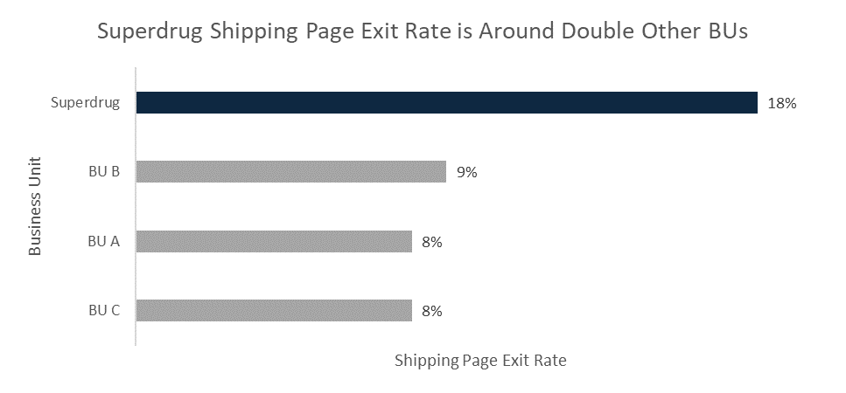

Slide 22
Great presentations don’t contain more insights.
They contain fewer, more relevant insights.

Slide 23


Why does it matter?
03.

Slide 24
Which one?
Recommendation 1
Recommendation 2
Make delivery details clearer on product page
Simplify the shipping page

Slide 25
Which one?
Recommendation 1
Recommendation 2
Make delivery details clearer on product page
Simplify the shipping page
£1,000K
Sales pa
£250K
Sales pa

Slide 26
Value shows why an insight is worth acting on.

Slide 27

What should happen next?
04.

Slide 28

Simplify the shipping page.

Slide 29
Simplify the shipping page by:

Slide 30

Simplify the shipping page by:
  Fred to speak to the Mobile App team to move secondary shipping info into expandable sections

Slide 31

Simplify the shipping page by:
  Fred to speak to the Mobile App team to move secondary shipping info into expandable sections
  Run a 6 week AB test
Notes:
Then run a 6 week AB test

Slide 32
Simplify the shipping page by:
  Fred to speak to the Mobile App team to move secondary shipping info into expandable sections
  Run a 6 week AB test
  Measure and compare the shipping page exit rate

Slide 33
An actionable recommendation reduces the effort for a stakeholder to say yes.

Slide 34

Summary

Slide 35
The Four Question Framework
Why are we here?

Slide 36
The Four Question Framework
Why are we here?
What have we learned?

Slide 37
The Four Question Framework
Why are we here?
What have we learned?
Why does it matter?

Slide 38
The Four Question Framework
Why are we here?
What have we learned?
Why does it matter?
What should happen next?

Slide 39
Great analytics shouldn’t end with an insight.
It should end with someone doing something differently.

Slide 40
Questions?
Notes:
Are there any questions?

Slide 41

Thanks for listening
Tom Price
Senior Commercial Manager
linkedin.com/in/tomgprice/
Notes:
Thank you so much for listening, it’s been a pleasure

